Slide 1
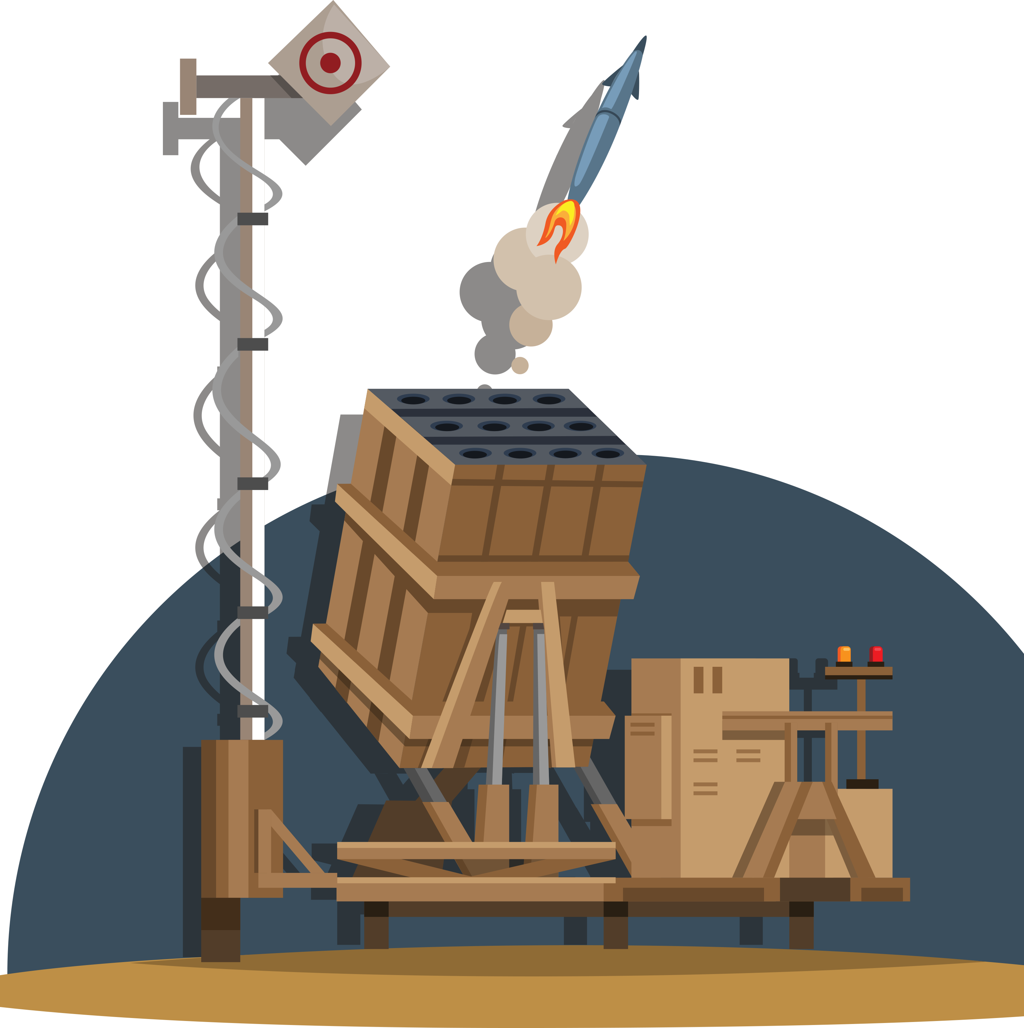

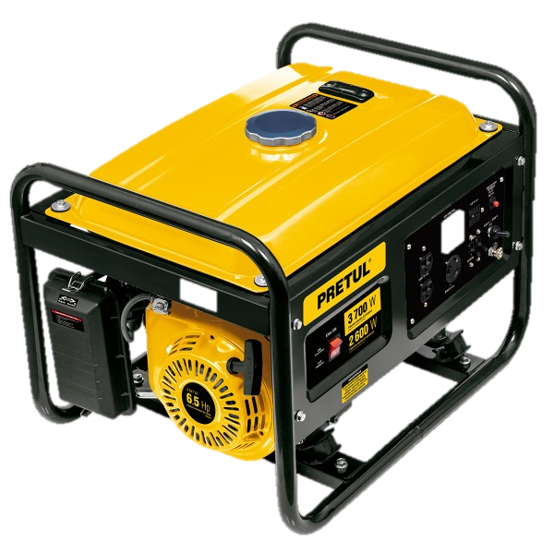

"The Sound of Trouble: Diagnosing Generator Issues by Ear"
מגישים:
דניאל צפריר
יוליה וכניש

Slide 2
Introduction
The purpose of this project is to develop an AI-based solution for anomaly detection in mobile generators that power critical infrastructure, particularly Iron Dome defense systems. The project aims to ensure continuous generator operation by using machine learning algorithms trained on acoustic data to detect faults and predict failures in real time. This proactive maintenance approach will help minimize downtime, reduce repair costs, and ensure the uninterrupted functionality of the generators, which are vital to the effectiveness of the defense system. The ultimate goal is to create a cost-efficient, rapid, and accessible solution for anomaly detection, enhancing the reliability and operational efficiency of these critical power systems.

Slide 3
The problem
Function and Lifespan: Generators convert mechanical energy into electrical energy, essential for applications from residential to industrial. With proper maintenance, they can operate for 10,000–30,000 hours, lasting 10–20 years.
Maintenance and Fault Detection: Routine upkeep (oil changes, filter replacements) extends lifespan. Monitoring for unusual sounds (e.g., knocking or grinding) helps detect faults early, preventing major repairs.
Environmental Impact: Outdoor generators face challenges like weather damage, corrosion, and debris. Protective enclosures and regular cleaning mitigate these risks, ensuring long-term performance.
Iron Dome Dependence: Generators power the Iron Dome defense system, requiring real-time anomaly detection to maintain uninterrupted operation. AI-based solutions offer proactive maintenance, enhancing reliability and minimizing downtime.

Slide 4


Existing methods
The ideal approach to maintaining the integrity of systems, particularly power systems, is to predict faults and prevent their occurrence.
The prediction is achieved by calculating the generator's operational time and reducing this time based on climate damage and usage. This adjusted time guides technicians in scheduling proactive maintenance. Often, this proactive maintenance is performed while the generator is still fully operational, leading to downtime and resource expenditure that is frequently unnecessary.
Another method involves fault detection through the auditory skills of experienced professionals who can identify issues by sound, having encountered numerous faults in the past. However, this method is inefficient due to the scarcity of such experienced professionals today and the unreliability of relying on human factors. Moreover, it cannot support real-time monitoring across multiple distributed points in the field.

Slide 5
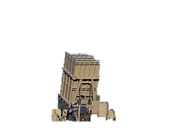
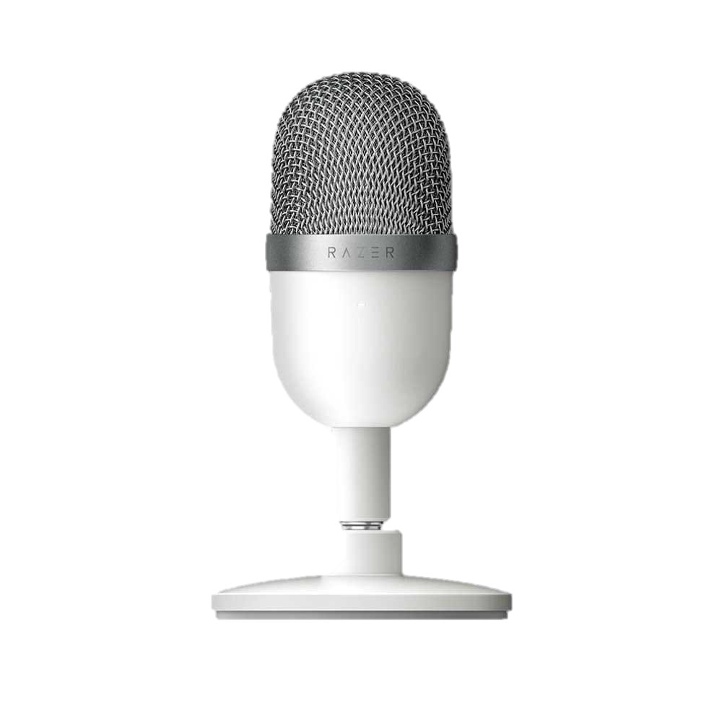



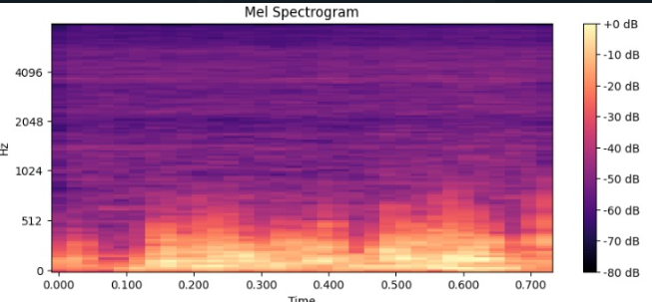
Data-Collection process
Audio recorders from various generators in .csv format
Split the WAV files into 1 second segments.
Convert a .CSV file to a .WAV file
Label the data and convert audio files to spectrograms.

Slide 6
AI Model
For the task of anomaly detection in mobile generators, we chose to implement a Convolutional Neural Network (CNN) model due to its proven effectiveness in analyzing structured data such as images and, by extension, spectrograms derived from acoustic data. The chosen model architecture is inspired by successful CNN architectures used in image and speech recognition tasks.

Slide 7
Dataset
Recording Types
Static Position: Microphone placed at a fixed point relative to the generator
Dynamic Position: Microphone position varied around the generator
Dataset Composition
Healthy Generator Recordings: Captured from both static and dynamic positions
Faulty Generator Recordings: Captured from both static and dynamic positions

Slide 8
Data Splitting
To ensure the model generalizes well to unseen data, the dataset is split into training, validation, and test sets. The training set is used to train the model, the validation set helps in tuning hyperparameters and preventing overfitting, and the test set provides an unbiased evaluation of the model's performance.

Slide 9
Training and Evaluation
Training Process
Model Optimization: Cross Entropy Loss, Backpropagation
Multiple Epochs: Track training and validation loss
Goal: Minimize overfitting and generalize well
Evaluation Metrics
Confusion Matrix: Visualize accuracy and misclassifications
Loss Plots: Compare training and validation loss trends
Testing on New Data
Preprocess new audio and validate predictions
Notes:
עכשיו, בואו נעבור על האופן שבו ביצענו אימון ו EVALUATION על המודל במטרה לסווג קטעי אודיו כמה שיותר מדויק.
ראשית, בתהליך האימון, אנו משתמשים בלולאה שעוברת דרך כל ספקטרוגרמה של שמע, מחשבת את ההפסד באמצעות Cross Entropy Loss, ומבצעת backpropagation לעדכון המשקלים. אימנו את המודל במספר אפוקים (התחלנו מ 3 והגענו גם ל 10), תוך כדי מעקב אחרי training and validation losses.
המפתח כאן היה להבטיח שהמודל למד את הpatternes הנכונים מבלי להתאים יותר מדי לנתוני האימון.
באופן אידיאלי, אנחנו רוצים שה training loss יקטן בעקביות, ה validation loss יתיישר או יקטן גם כן.
אם ה validation loss גדל בעוד ה training loss פוחת, זה סימן ל overfitting.
ל evaluation, אנו משתמשים ב confusion matrix כדי לראות עד כמה המודל מבחין בין צלילים 'נורמליים' ו'לא נורמליים'.
המטריצה ​​מראה איפה המודל עושה ניבויים נכונים ושגויים.
ל confusion matrix טוב יהיו רוב הערכים לאורך האלכסון, כלומר תחזיות מדויקות. כל ערכים מחוץ לאלכסון מציגים סיווגים שגויים, ועוזרים לנו לזהות אזורים שבהם המודל עדיין זקוק לשיפור.
לבסוף, אנו בודקים את המודל על נתונים שהוא לא מכיר על ידי העברת קובץ שמע חדש דרך אותו pipeline מקדים. אם התחזיות של המודל תואמות עם labals ידועים, זה מאשר שהוא למד דפוסים משמעותיים מה training data שלנו.
המודל הזה עוזר לנו להשיג מודל חזק, כללי המסוגל לסווג נתוני אודיו מהעולם האמיתי במדויק."
cross-entropy loss - מספר לנו עד כמה קרובות (או רחוקות) התחזיות של המודל מהתשובות האמיתיות
ADAM - פופולרי מכיוון שהוא מתאים את קצב הלמידה (learning rate ) במהלך האימון, מה שהופך אותו למהיר ויעיל יותר.
Accuracy: (TP+TN)/total predictions(TP + TN)– overall correctness.
Precision: TP/(TP+FP)TP / (TP + FP)TP/(TP+FP) – correctness of positive predictions.
Recall: TP/(TP+FN)TP / (TP + FN)TP/(TP+FN) – sensitivity, or the ability to find all actual positives.
F1 Score: 2×(Precision×Recall)/(Precision+Recall)– balance between precision and recall.

Slide 10
Experiment
After using a reduced VGG16 model adapted to our experiment (based on a similar study done at Ariel University on noise anomaly detection in drones) we first got "too good" results which was suspicious and we tried to think what could have caused it.
In the first experiment we wanted to test the effect of the different types of recordings we have without adding noise.

Slide 11
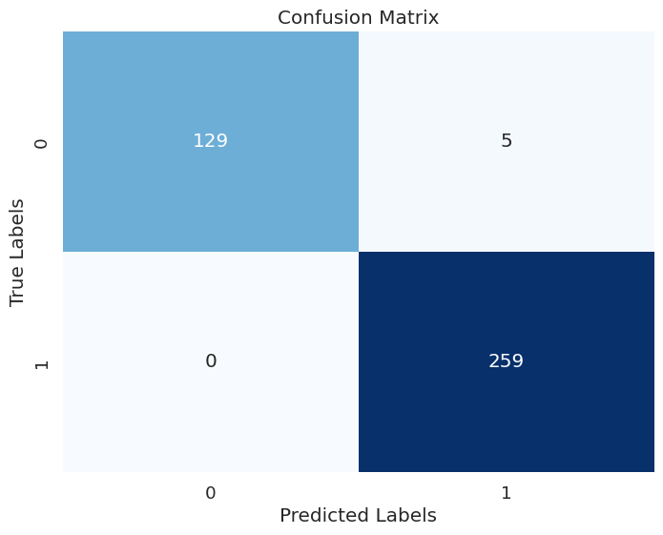
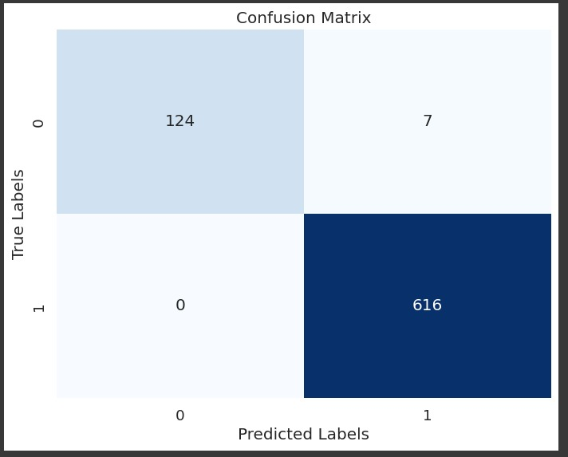
Experiment
ניקח הקלטות של S1 (מיקום קבוע)
עכשיו נסתכל על הקלטות של S2 (מיקום משתנה)
בלי רעש

Slide 12
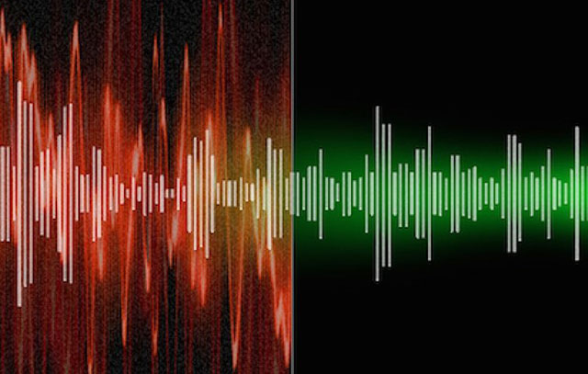
Experiment
During our initial experiment, we found that the model was trained on overly simplistic data. To enhance its robustness, we used corrupted 50% of the training data randomaly. The added noises included:
Salt pepper noise
Gaussian noise
Speckle noise
Uniform noise

Slide 13
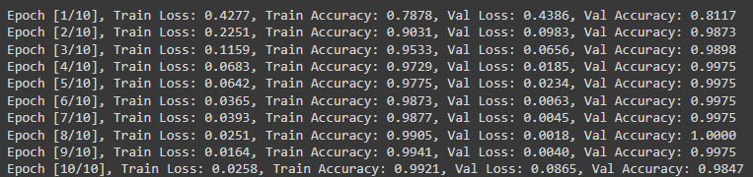
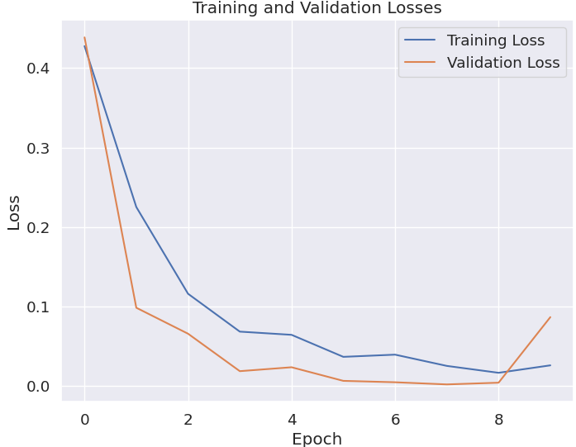
Results
After the adjustments of adding the noise we got the following results:

Slide 14
Results
Final results of the model in reference to all
The information with the noise:

Slide 15
Conclusion
Study Outcome: Developed and evaluated a neural network model for anomaly detection using audio data with high performance (95% accuracy, 94% precision, 93% recall, 93.5% F1-score).
Key Process: Audio converted to Mel spectrograms and processed through a convolutional neural network to capture essential features. The primary challenge lies in collecting audio data from malfunctioning generators for effective model training.
Practical Applications: Automates generator diagnostics and maintenance, enhancing operational efficiency, safety, and fault detection by accurately identifying anomalies and assigning feedback to the correct personnel.

Slide 16
Future Work
Converting a car engine noise simulator as a digital twin to the generator noises
Reference to the vibration files: examination of time series algorithms for the purpose of analyzing the vibration files (provides additional value as a feature for the model)
Adapting the existing model to multiclass problem areas (reference to the types of faults)
Notes:
Future Work
Examine Vibration Data:
Explore time-series algorithms (e.g., ARIMA, LSTM) for in-depth vibration analysis
Integrate vibration features to enhance fault detection accuracy
Expected Benefits:
Richer Feature Set: Adds complementary data to improve model reliability
Potential for Early Detection: Could capture issues not evident in audio alone

Slide 17

Thank You For Listening

